Slide 1
Greedy Technique

Slide 2
Greedy Technique
Constructs a solution to an optimization problem piece by
piece through a sequence of choices that are:
feasible, i.e. satisfying the constraints
locally optimal (it has to be the best local choice among all feasible choices available on that step)
greedy (once made it can not be changed on subsequent steps of the algorithm), and irrevocable
For some problems, it yields a globally optimal solution for every instance. For most, does not but can be useful for fast approximations.
Defined by an objective function and a set of constraints

Slide 3
Applications of the Greedy Strategy
Optimal solutions:
  change making for “normal” coin denominations
  minimum spanning tree (MST)
  single-source shortest paths
  simple scheduling problems
  Huffman codes
Approximations/heuristics:
  traveling salesman problem (TSP)
  knapsack problem
  other combinatorial optimization problems

Slide 4
Change-Making Problem
Given unlimited amounts of coins of denominations d₁ > … > d_{m} ,
give change for amount n with the least number of coin denominations
Example: d₁ = 25c, d₂ =10c, d₃ = 5c, d₄ = 1c and n = 48c

Slide 5
Minimum Spanning Tree (MST)
Spanning tree of a connected graph G: a connected acyclic subgraph of G that includes all of G’s vertices
Minimum spanning tree of a weighted, connected graph G: a spanning tree of G of the minimum total weight
Example:
6
c
6
c
c
a
a
a
4
1
4
1
1
2
2
d
d
d
b
3
b
b
3

Slide 6
Prim’s MST algorithm
Start with tree T₁ consisting of one (any) vertex and “grow” tree one vertex at a time to produce MST through a series of expanding subtrees T₁, T₂, …, T_{n}
On each iteration, construct T_{i+1} from T_{i} by adding vertex not in T_{i} that is closest to those already in T_{i} (this is a “greedy” step!)
Stop when all vertices are included
Prim’s alg constructs a minimum spanning tree through a sequence of expanding sub trees.

Slide 7
Example
4
c
4
c
4
c
a
a
a
1
1
1
6
6
6
2
2
2
d
d
d
b
3
b
3
b
3
4
c
4
c
a
a
1
1
6
6
2
2
d
d
b
3
b
3

Slide 8
Algorithm - Prim’s algorithm
V_{T}← {V₀}
E_{T}← 0
For i← 1 to |V| -1 do
  Find a minimum weight edge e* = (v*,u*) among all the edges (v , u) such that v is in V_{T} and u is in V-V_{T}
  V_{T} ← V_{T} U {u*}
  E_{T} ← E_{T} U {e*}
Return E_{T}

Slide 9
Efficiency
Depends on data structure chosen for the graph and the priority queue of the set V-V_{T} whose vertex priorities are the distances to the nearest tree vertices
for example, if a graph is represented by its weight matrix and the priority queue is implemented as an un ordered array then algorithm running time will be Θ(|V| ²) (adjacency matrix)

Slide 10
Another greedy algorithm for MST: Kruskal’s
Sort the edges in nondecreasing order of lengths
“Grow” tree one edge at a time to produce MST through a series of expanding forests F₁, F₂, …, F_{n-1}
On each iteration, add the next edge on the sorted list unless this would create a cycle. (If it would, skip the edge.)

Slide 11
Example
4
c
4
c
4
c
a
a
a
1
1
1
6
6
6
2
2
2
d
d
d
b
3
b
3
b
3
4
c
c
c
a
a
a
1
1
1
6
6
2
2
2
d
d
d
b
3
b
3
b
3

Slide 12
Notes about Kruskal’s algorithm
Algorithm looks easier than Prim’s but is harder to implement (checking for cycles!)
Cycle checking: a cycle is created iff added edge connects vertices in the same connected component
Running time will be dominated by the time needed for sorting the edge weights of a given graph. Efficient sorting n log n
Runs in O(m log m) time, with m = |E|. The time is mostly spent on sorting.

Slide 13
Algorithm for Kruskals
E_{T}← 0; ecounter← 0 //No of Tree edges
K← 0 //no of processed edges
While ecounter < |V| -1
  k← k+1
  If E_{T} U {e _{ik}} is acyclic
    E_{T} ← E_{T} U {e_{ik}} ; ecounter← ecounter+1
  Return E_{T}

Slide 14
Shortest paths – Dijkstra’s algorithm
Single Source Shortest Paths Problem: Given a weighted
connected (directed) graph G, find shortest paths from source vertex s
to each of the other vertices
Dijkstra’s algorithm: Similar to Prim’s MST algorithm, with
a different way of computing numerical labels: Among vertices
not already in the tree, it finds vertex u with the smallest sum
d_{v} + w(v,u)
where
v is a vertex for which shortest path has been already found
on preceding iterations (such vertices form a tree rooted at s)
d_{v} is the length of the shortest path from source s to v
w(v,u) is the length (weight) of edge from v to u

Slide 15
Example
b
4
c
3
6
7
2
5
4
a
d
d
e
Tree vertices Remaining vertices
a(-,0) b(a,3) c(-,∞) d(a,7) e(-,∞)
4
b
c
3
2
6
5
a
7
d
4
e
b(a,3) c(b,3+4) d(b,3+2) e(-,∞)
b
4
c
3
6
2
5
a
7
d
4
e
d(b,5) c(b,7) e(d,5+4)
b
4
c
3
6
2
5
a
7
d
4
e
c(b,7) e(d,9)
4
b
c
3
6
2
5
a
7
d
4
e
e(d,9)

Slide 16
Notes on Dijkstra’s algorithm
Correctness can be proven by induction on the number of vertices.
Doesn’t work for graphs with negative weights (whereas Floyd’s algorithm does)
Applicable to both undirected and directed graphs
Efficiency
  O(|V|²) for graphs represented by weight matrix and array implementation of priority queue
We prove the invariants: (i) when a vertex is added to the tree, its correct distance is calculated and (ii) the distance is at least those of the previously added vertices.

Slide 17
Dijkstra’s algorithm
Initialize(Q)
For every vertex v in V do
  d_{v} ← ∞; p_{v} ← null
  Insert(Q, v, d_{v}) //Initialize vertex priority in the priority queue
D_{s}←0 ; decrease(Q,s,d_{s}) // update the priority queue
V_{T}← 0
For i← 0 to |V| -1 d0
  U*← deletemin(Q) //delete the minimum priority element
  V_{T} ← V_{T} U {u*}
  For every vertex u in V- V_{T} that is adjacent to u* do
    If d_{u}* +w(u*,u)<du
      d_{u}←d_{u}*+w(u*,u); p_{u}←u*
      Decrease(Q,u,d_{u})

Slide 18
Coding Problem
Coding: assignment of bit strings to alphabet characters
Codewords: bit strings assigned for characters of alphabet
Two types of codes:
fixed-length encoding (e.g., ASCII)
  Assigns fixed or standard no of chars to each code
variable-length encoding (e,g., Morse code)
Morse(telegraph code frequent letters e(.) and a(.___) used in 19th century
  Assigns code words of different lengths to different chars
Prefix-free codes (or prefix-codes): no codeword is a prefix of another codeword
Problem: If frequencies of the character occurrences are
known, what is the best binary prefix-free code?
E.g. We can code {a,b,c,d} as {00,01,10,11} or {0,10,110,111} or {0,01,10,101}.
E.g. if P(a) = 0.4, P(b) = 0.3, P(c) = 0.2, P(d) = 0.1, then the average length of code #2 is 0.4 + 2*0.3 + 3*0.2 + 3*0.1 = 1.9 bits
It allows for efficient (online) decoding!
E.g. consider the encoded string (msg) 10010110…

Slide 19
Huffman codes
Any binary tree with edges labeled with 0’s and 1’s yields a prefix-free code of characters assigned to its leaves
Optimal binary tree minimizing the average
length of a codeword can be constructed
as follows:
Huffman’s algorithm
Initialize n one-node trees with alphabet characters and the tree weights with their frequencies.
Repeat the following step n-1 times: join two binary trees with smallest weights into one (as left and right subtrees) and make its weight equal the sum of the weights of the two trees.
Mark edges leading to left and right subtrees with 0’s and 1’s, respectively.
0
1
0
1
1
represents {00, 011, 1}

Slide 20
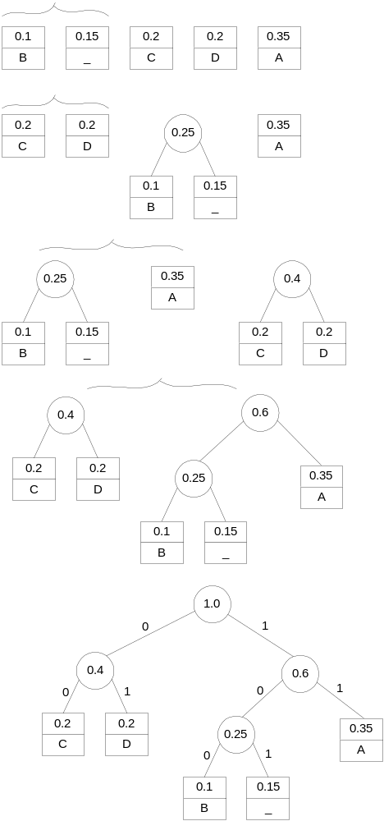
Example
character A B C D _
frequency 0.35 0.1 0.2 0.2 0.15
codeword 11 100 00 01 101

